Slide 1
Study/Task Planner App
Maheen Siddique -200480228
Cirus Chakma-200495194
Linton Dsouza- 200470698
07/30/2025
Software Testing and Validation (ENSE 375)

Slide 2
Agenda
Introduction
Problem Definition
Design Requirements
Solutions
Testing and Demonstration
Project Management
Conclusion and Future Scope

Slide 3
Introduction
Background:
Students often struggle with organizing study sessions effectively, leading to procrastination and missed deadlines.
An in-built task-planner shippable with any laptop of any specification makes this app accessible to a massive demographic of people.
Need:
A digital solution that allows the user to schedule tasks based on priorities, time availability, and user preferences.
Ensuring robustness and reliability via thorough testing.
Technology Stack:
Java, JavaFX for UI, SQLite for data storage.
Test-Driven Development (TDD) to ensure high code quality.

Slide 4
Problem Definition
Problem:
Lack of automated tools that combine task management with intelligent scheduling.
Inconsistent user experience due to poor testing of existing apps.
Goal:
Develop a Study Session Planner that is intuitive, reliable, and bug-free by integrating testing at every stage.
TDD for an experience tailored to be intuitive and easy-to-learn.
Persistent storage to retain a history of completed and ongoing tasks even after application termination or power loss.

Slide 5
Design Requirements
Functions:
Add, edit, and delete tasks.
Set reminders and deadlines.
Display tasks in a calendar view.
Objectives:
Minimize scheduling conflicts.
Provide an easy-to-use UI.
Ensure all critical functionalities are fully tested.
Constraints:
Timeframe: 8 weeks.
Tools restricted to JavaFX and lightweight RDBMS
Must follow software testing standards (unit, integration, system tests).

Slide 6
Solutions
Evaluated Solutions Overview
🔹 Solution 1: Command-Line Scheduler
Design: Lightweight Java CLI app reading from CSV to generate plain text schedule.
Strengths:
Easy Path/Data-flow & CFG testing
High code coverage (≥90%)
Weaknesses:
Minimal validation (no boundary/equivalence class tests)
Poor usability (SUS < 70)

Slide 7
Solution 2
Swing GUI Scheduler
Design: Java Swing GUI to import CSV, set availability, and view read-only schedule.
Strengths:
Integration testing possible via GUI/scheduler separation
Allows boundary & decision table testing
Weaknesses:
Limited interactivity (read-only schedule view)
Threading issues (Swing event-dispatch)
Still not MBT/test-case friendly

Slide 8
Solution 3
JavaFX GUI + DB Integration
Design: JavaFX app with persistent DB support and dynamic user interaction.
Features:
Store & retrieve tasks/schedules
Drag-drop task view with filters/priorities
Why It’s Better:
Superior usability & SUS score
Interactive calendar
Test coverage includes all previous criteria + user satisfaction

Slide 9
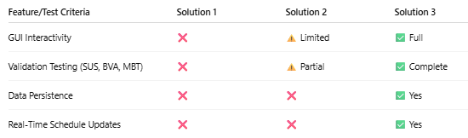
Comparison Chart

Slide 10
Testing & Demo
Test-Driven Development (TDD):
We used TDD to create test cases before implementing features.
Each feature was added only after its corresponding unit test passed.
Black-Box vs White-Box Testing:
Black-Box: Tested all user workflows (task dialogs, calendar navigation, timer alerts) without code access.
White-Box: Covered internal logic (addTask validation, timer computations) via code inspection.
Validation Testing:
ECT: Adding a task with valid details succeeds and “High” priority tasks are correctly classified as High.
BVT:Tasks with a 1-minute duration and a complexity of 10 are accepted and stored correctly.
State-Transition Testing: Completing an ongoing task moves it from “ongoing” to “completed” and can’t be reverted.
Use Cast Testing: A newly added task appears in the calendar, and upon completion the calendar and task lists update correctly.
Data Flow and Integration Testing:
Saving a task persists all its properties in and loading retrieves them exactly as set.
End-to-end DB persistence is verified by inserting, updating, and querying tasks

Slide 11
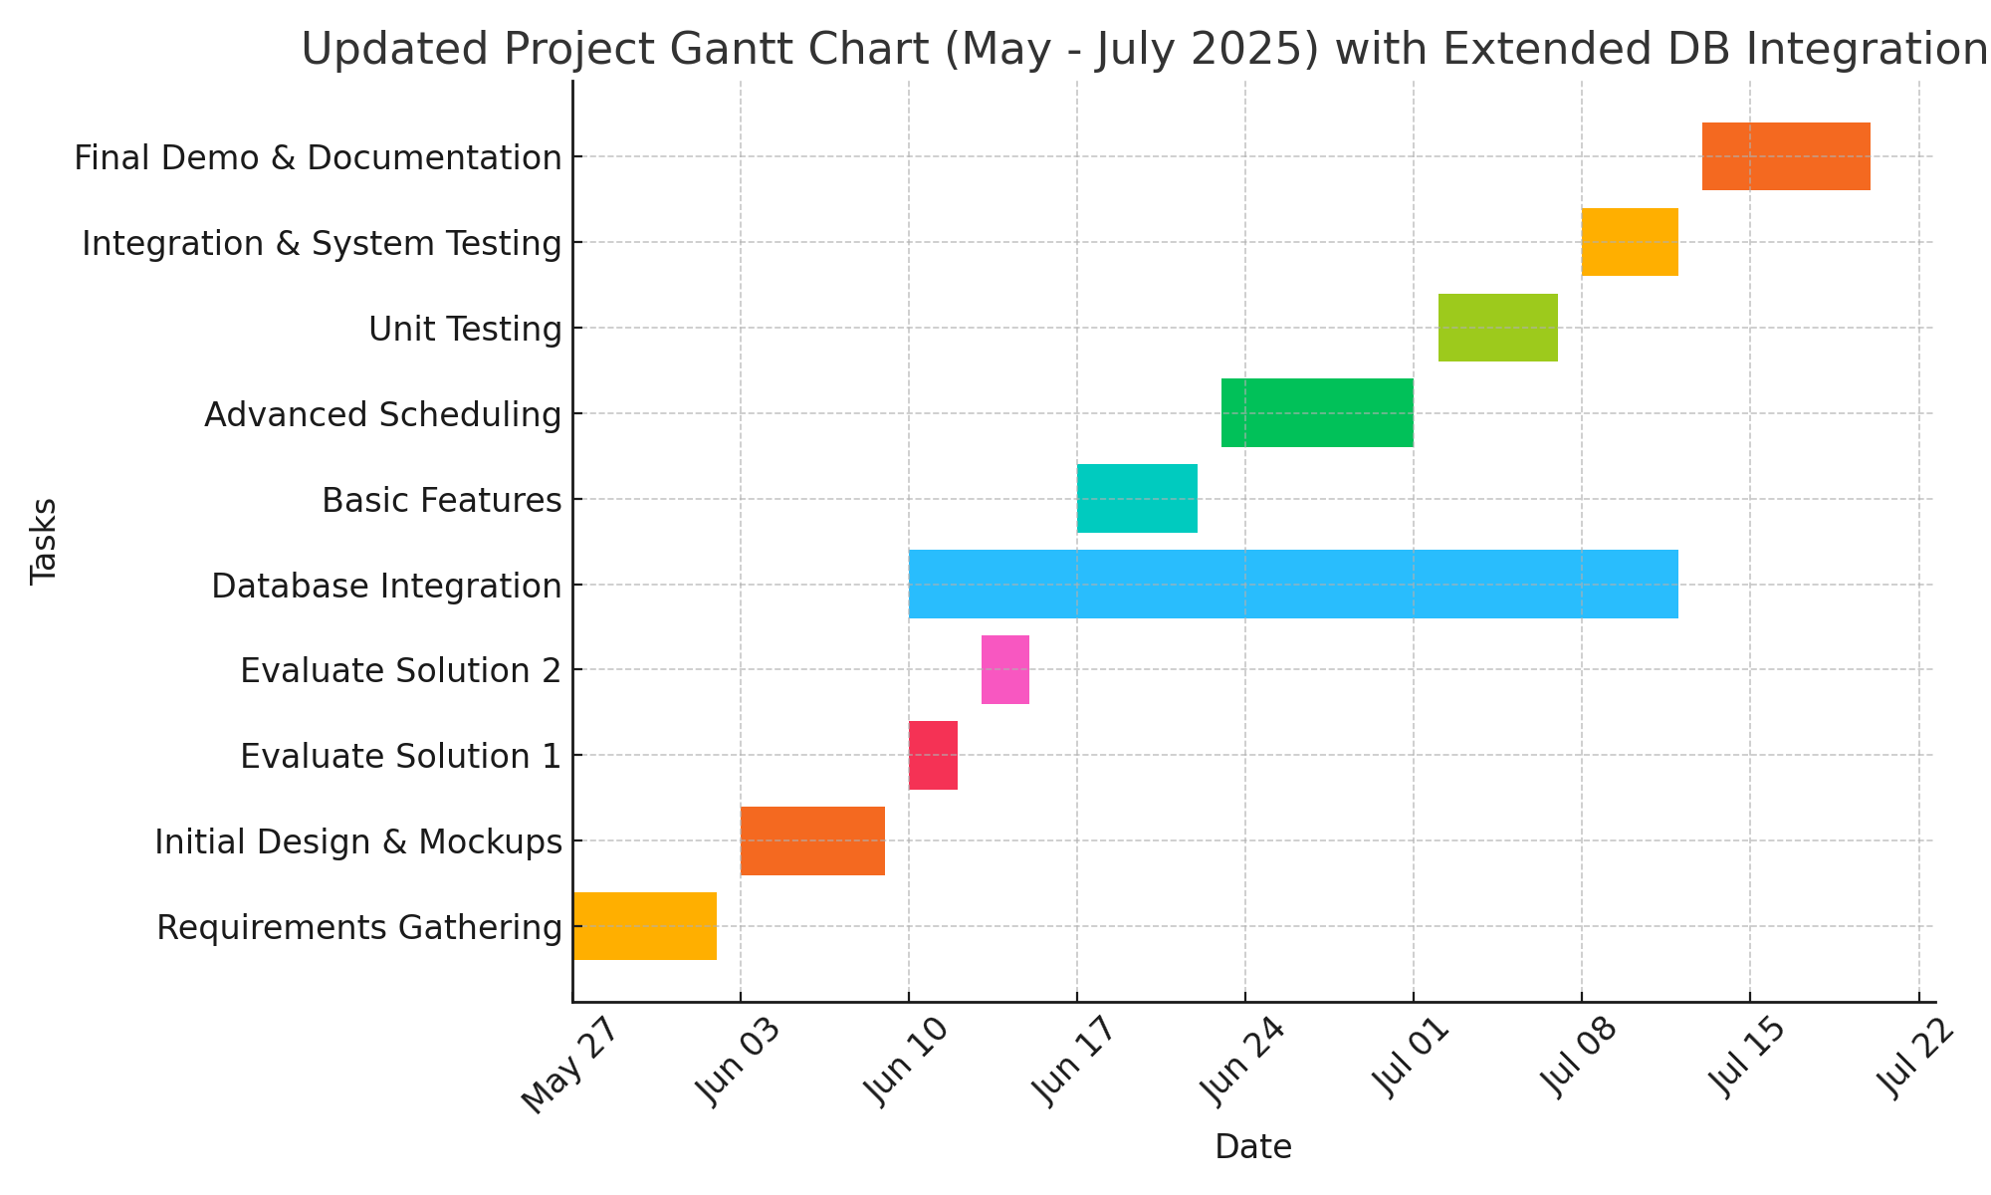
Project Management

Slide 12
Conclusion and Future Work
Conclusion
Delivered a JavaFX Study Planner with calendar UI, SQLite persistence, and interactive timers
Designed, developed, and tested the software application via JUnit/TDD.
Produced a comprehensive test suite covering unit, integration, data-flow, and path testing
Applied all required test techniques.
Future works
Extend and Automate GUI tests, add performance and security testing.
Integrate CI/CD pipeline with GitHub Actions for automated builds and test runs.
Add more features to GUI and to the application overall.
Migrate DB to cloud storage for cross-device sync

